Slide 1

Smart IoT Robot for Environmental Monitoring
A collaborative project by Mohammed Jaber and Amal Kandeel
Advised by Dr. Naomi Unkelos Shpigel
TAMK University of Applied Sciences
in collaboration with TAMK.
Capstone_Phase-A_25-2-D-11

Slide 2
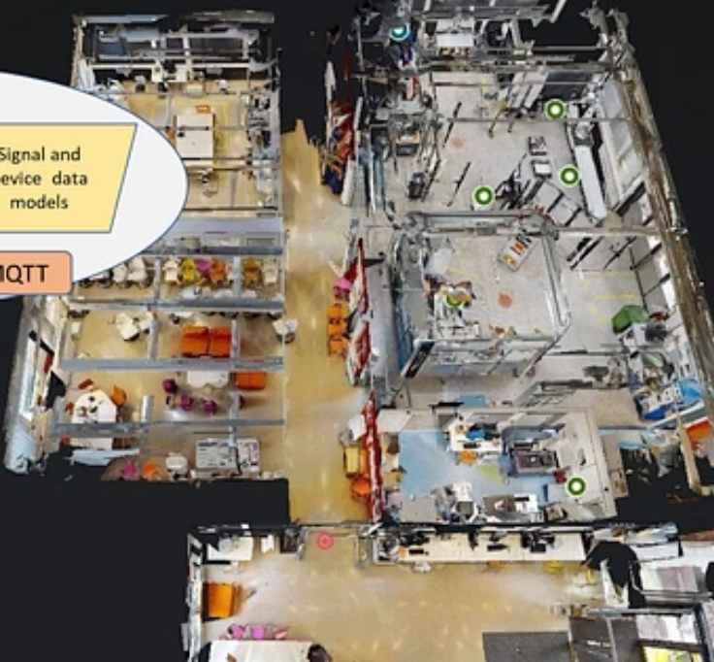


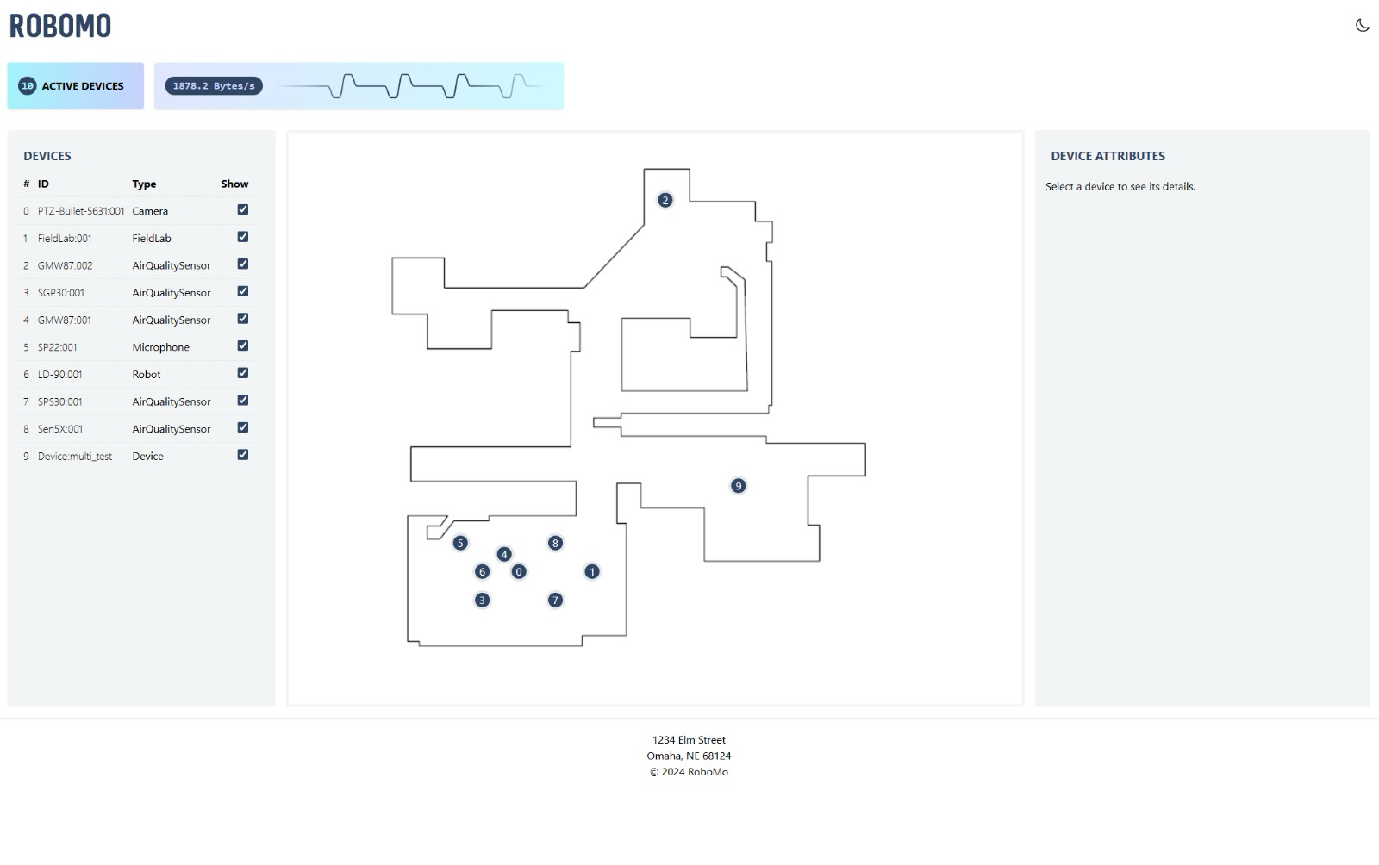
What is TAMK?
Tampere University of Applied Sciences (TAMK) is one of Finland's largest universities of applied sciences.
Known for its expertise in technology, business, healthcare, and media.
Robomo 1.0:
Or and DIMA Project
Mr. Kari Naakka
Our Project Manager at TAMK

Slide 3
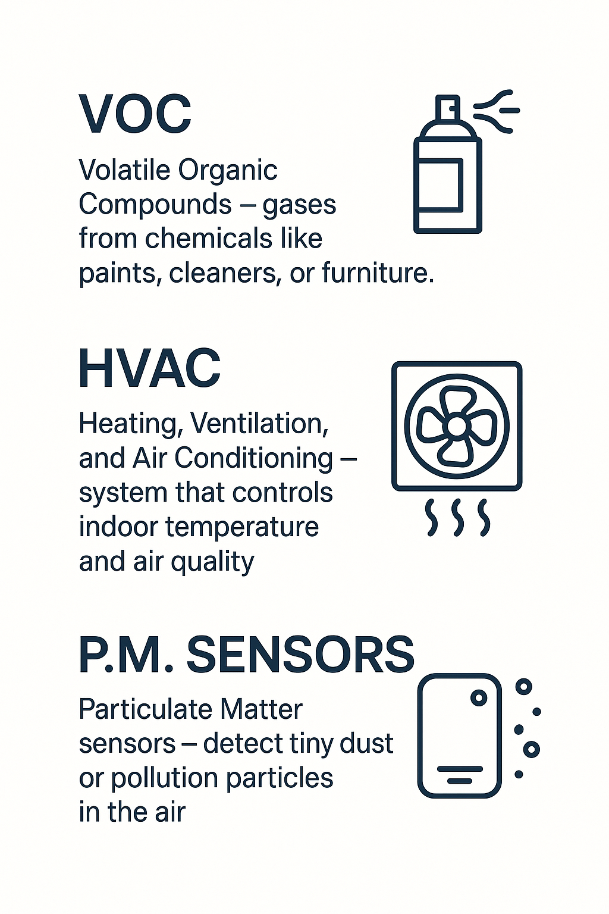
Problem Statement & Motivation
01
02
03
04
Indoor air quality often goes unnoticed, leading to health issues and reduced productivity. Existing solutions are often static, incomplete, or lack smart automation.
Hidden indoot air pollutants (C02, VOCs ,etc.).
Suboptimal ventilation and purification system
Fixed sensors miss localized issue
Lack of real-time, actionable insights

Slide 4

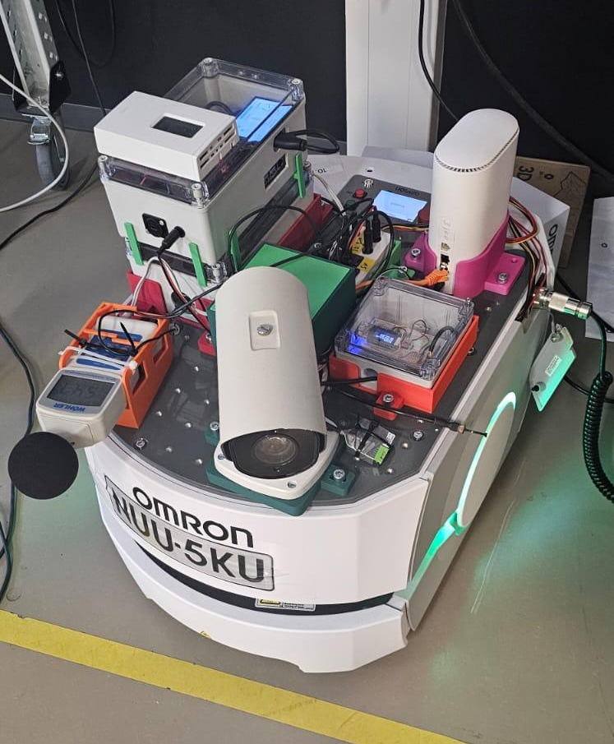



Innovation
Smart Robot Integration
Real-time CO₂, VOC, temperature, humidity and P.M sensors with ML-driven health index for automated HVAC/purification.
Dynamic Control
System detects specific causes (CO₂, VOC, etc.) and acts accordingly (ventilation, fan, purification) for optimal indoor air.
Mobile Monitoring
Robot navigates to "problem spots," offering more comprehensive
coverage than fixed sensors.
Modular Add-ons
Easy upgrades with new sensors (pressure, light)
or advanced ML models.

Slide 5
Project Objectives
Develop a Smart Robot Prototype
Integrate sensors (CO₂, VOC, Temp, Humidity, P.M) for accurate indoor air quality data.
Implement Machine Learning Models
Create a health index and enable automated control of HVAC/ventilation/purification systems.
Ensure Mobile Monitoring Capability
Allow the robot to autonomously navigate and collect data from various locations.
Design for Modularity & Scalability
Enable easy integration of new sensors and advanced ML algorithms for future enhancements.

Slide 6



Existing Systems & Gaps
Fixed Sensors
Basic HVAC Systems
Limited coverage, cannot detect localized
issues effectively.
Lack intelligent, real-time adjustments based on air quality data.
Current solutions often miss the nuances of indoor environmental control. Our robot aims to fill these gaps by offering dynamic, mobile, and intelligent monitoring and response.

Slide 7
Current Progress
Started working on the project
First meeting with Kari
Produced a plan
Talked about the current project status, discussed ideas and got our first assignment
Tested machine learning models on room occupancy detection, generated ideas for new sensor and data use cases
Evaluated machine learning models on all use cases, started writing the capstone book and working on the presentation.
26/03/2025
04/05/2025
03/06/2025
30/04/2025
10/05/2025
04/06/2025
Meeting with Or and Dima
Started
researching
Follow-up meeting with Kari
Informed Kari on test results, suggested smoke/fire detection, HVAC control and health index use cases
Learned about the project, architecture and received all the needed data and tools.
Started researching:
Occupancy detection
Air quality sensors use cases

Slide 8













System Architecture
Our Contribution:
Client
Firebase API
Frontend
HTML 5
React
JavaScript
Tailwind
WebSocket
Firebase API
Server
Agent
TAMK API
Backend
TAMK
Fiware
Node.js
WebSocket
MQTT
Python

Slide 9
Functional Requirements
Occupancy Detection
Utilize CO₂, temperature, humidity, VOC and P.M sensors for accurate room occupancy detection.
Real-time Dashboard
Display live sensor data and an integrated Health Index on a web-based dashboard.
Alert System
Trigger immediate alerts for abnormal air quality conditions (e.g., high CO₂, smoke detection).
Recommendations & Notifications
Send actionable recommendations or notifications for manual intervention (e.g., ventilation activation).
Data and Actions Logging
Log all sensor readings, alerts and agent actions for historical analysis and review.

Slide 10
Non-Functional Requirements
Performance
Scalability
Dashboard updates within 1 second of sensor input.
Supports current 8 sensors, scalable to 20 sensors total without major redesign.
Privacy
Availability
No cameras or personally identifiable data used. Complies with GDPR to ensure lawful, fair, and transparent processing of environmental data.
Maintains at least 95% uptime during operational hours.
Usability
Intuitive, user-friendly UI for desktop and mobile.

Slide 11

Challenges We Faced
Dataset Limitations
Limited availability of datasets meeting our specific requirements.
No labeled data for head count using our sensor set.
Existing datasets do not reflect our exact lab environment.
TAMK misalignment
Lack of precise information on the TAMK lab dimensions and HVAC unit locations.
Limited coordination opportunities, as their break coincided with our semester.
The robot was not always operational for data collection.

Slide 12
Machine Learning Framework
Datasets
Evaluation Metrics
Fitness-gym and Living-room Occupancy Estimation (Mendeley Data)
Air Quality Classification (Kaggle)
Smoke Detection (Kaggle)
Accuracy – % of correct predictions
Precision – % of predicted positives that are correct
Recall – % of actual positives found
F1 – Balance of precision & recall
MAE – Average absolute error
RMSE – Root mean squared error
R² – How much variance is explained (higher is better)
Models
KNN
Random Forest
XGBoost
LightGBM
SVM
Logistic Regression

Slide 13
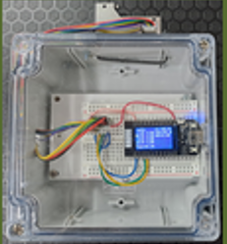
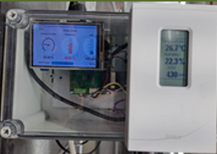
Occupancy Detection
By using these advanced sensors, we detect when rooms are occupied, allowing us to control the environment more efficiently and improve air quality
Sen5X_SCD41:001:
GMW87:001:
Measures CO₂, PM, VOCs, temperature, and humidity for detailed air quality monitoring.
Measures CO₂, temperature, and humidity for quick occupancy and air quality checks.

Slide 14
Room Occupancy Estimation: Model Performance
Model | Accuracy | Precision | Recall | F1Balance of precision & recall
KNN | 0.952378 | 0.952371 | 0.952378 | 0.952366
Random Forest | 0.951691 | 0.951580 | 0.951691 | 0.951629
XGBoost | 0.935856 | 0.935431 | 0.935856 | 0.935511
LightGBM | 0.932930 | 0.932297 | 0.932930 | 0.932503
SVM | 0.780438 | 0.764408 | 0.780438 | 0.758536
Logistic Regression | 0.719627 | 0.603513 | 0.719627 | 0.641736

Slide 15
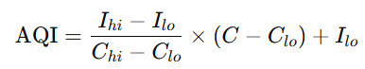
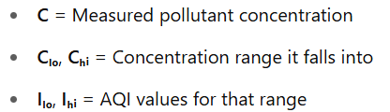
Health Index & Decision Logic
The health index aggregates various environmental parameters into a single, actionable score. This score drives intelligent decision logic, triggering automated responses to maintain optimal indoor conditions.
AQI (Air Quality Index) Formula
Final AQI = highest AQI among all pollutants

Slide 16
Air Quality Classification: Regression Model Performance
Model | MAE (Average of how far predictions are from actual values) | RMSE (Like MAE but gives more weight to big errors) | R2 (Measures how well the model explains the data)
RandomForest | 0.030005 | 0.680490 | 0.995966
LightGBM | 0.251340 | 2.124422 | 0.960683
XGBoost | 0.283394 | 2.189213 | 0.958249
LinearReg | 5.291437 | 6.702015 | 0.608703
KNN | 4.831589 | 6.768823 | 0.600863
SVR | 5.817051 | 7.397784 | 0.523241

Slide 17
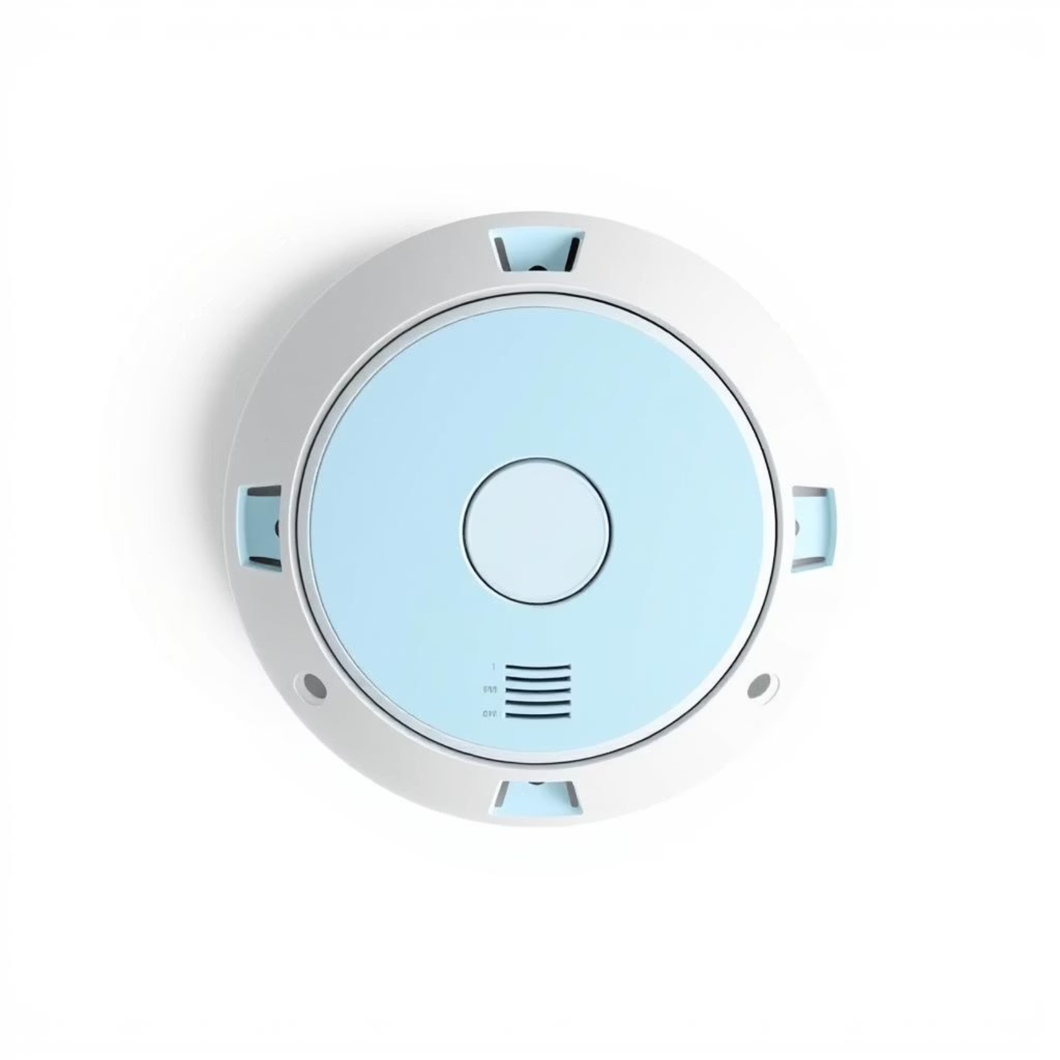
Smoke and Fire Detection
Particulate matter sensors are crucial for early smoke and fire detection. These sensors continuously monitor the concentration of tiny airborne particles, like PM2.5 and PM10, which spike sharply when smoke is present
The PM sensor unit pictured here is used to continuously monitor fine airborne particles. Its readings provide real-time alerts for smoke and fire detection, ensuring early warning and fast response.

Slide 18
Smoke Detection: Model Performance
Model | Accuracy | Precision | Recall | F1
LightGBM | 0.999760 | 0.999777 | 0.999888 | 0.999832
XGBoost | 0.999760 | 0.999888 | 0.999777 | 0.999832
Random Forest | 0.999441 | 0.999665 | 0.999553 | 0.999609
KNN | 0.992496 | 0.991564 | 0.997989 | 0.994766
SVM | 0.931981 | 0.950796 | 0.954195 | 0.952492
Logistic Regression | 0.777503 | 0.771638 | 0.978103 | 0.862689

Slide 19
Success Criteria & Impact
Optimized Air Quality
Enhanced Health Index
CO₂ below 1000 ppm, VOCs "good" (<500 μg/m³) (90% time).
Health score >80 (90% day), ensuring healthier, more comfortable indoor air.
Accurate Occupancy & Automation
Increased Productivity & Coverage
>99% occupancy accuracy, HVAC automation for 10–30% energy savings.
5–10% productivity boost, 20–40% fewer complaints; mobile monitoring identifies 20–40% more problem spots.

Slide 20
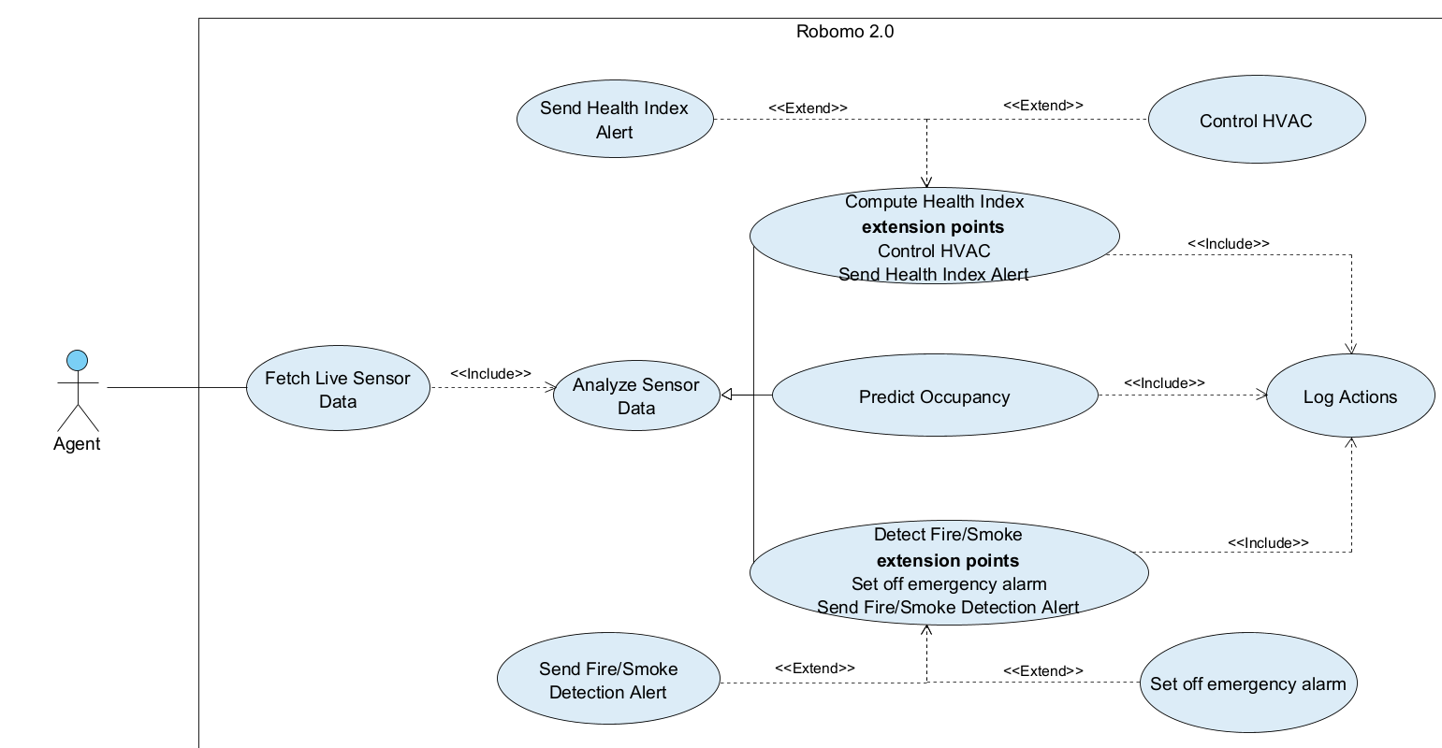
Use Case:
Our Contribution:

Slide 21
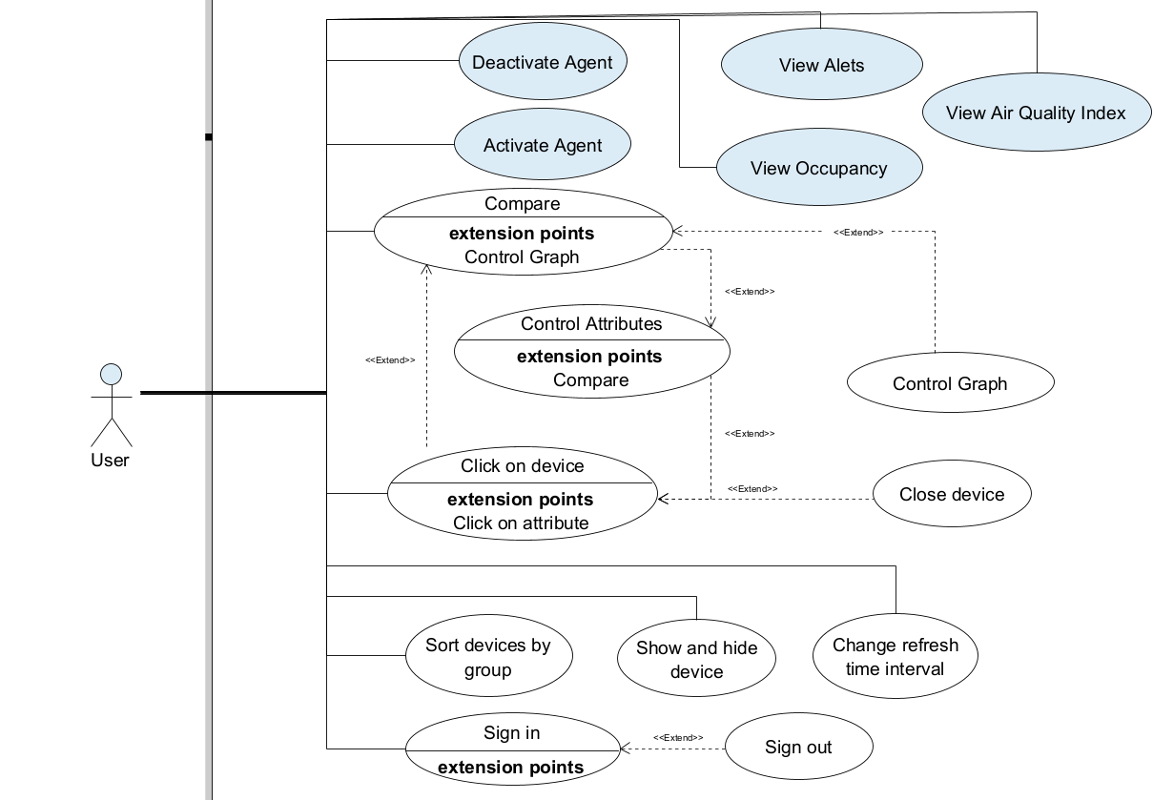
Our Contribution:

Slide 22
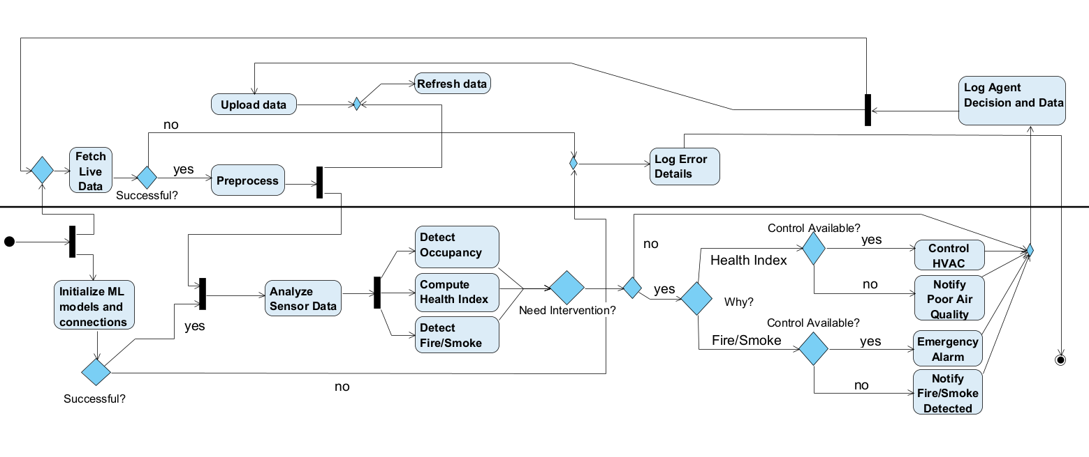
Activity
Our Contribution:
System
Agent

Slide 23




What's Next
Cloud Integration Store sensor data in the cloud for long-term access and analysis.
Improved Autonomy Train models using real robot-collected data for smarter decision making.
Smarter Navigation Use data logs to improve how the robot moves and locates problem areas.
Alert & Notification System Display critical air quality warnings and recommendations on the website.
23

Slide 24
Thanks!
Do you have any questions?

